Slide 1




‘STIMULATION OF CELL LINEAGES INVOLVED IN THE REPAIR OF THE GASTRIC MUCOSA (MG) DUE TO THE ULCEROGENIC ACTION OF ACETIC ACID (AC) IN RATS’
Bedini OA, Naves AE, San Miguel P, Petrich K, Vasquez V, Folmer P, Fabbro G, Fabbrizi MR, Flores Trusso L, Villaggi C.
ID 426
DEPARTMENT OF EXPERIMENTAL GASTROENTEROLOGY – FCM UNR
Stimulation of cell lineages involved in the repair of the gastric mucosa (MG) due to the ulcerogenic action of acetic acid (AC) in rats
Objective:
To stimulate the cellular intrinsic mechanisms of MG repair, by the ulcerogenic action of AC administered in a sub-serous form in the stomach, in rats.

Slide 2
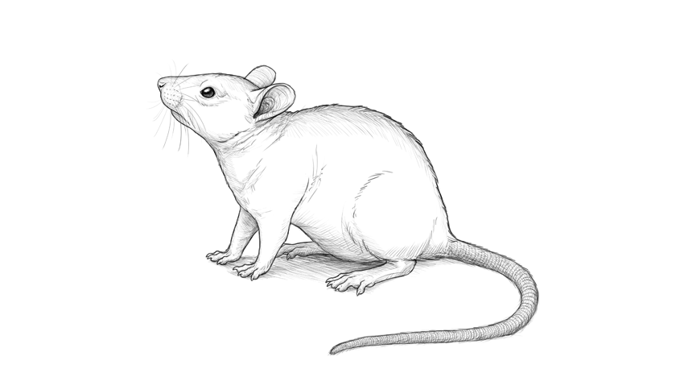
‘STIMULATION OF CELL LINEAGES INVOLVED IN THE REPAIR OF THE GASTRIC MUCOSA (MG) DUE TO THE ULCEROGENIC ACTION OF ACETIC ACID (AC) IN RATS’
Bedini OA, Naves AE, San Miguel P, Petrich K, Vasquez V, Folmer P, Fabbro G, Fabbrizi MR, Flores Trusso L, Villaggi C.
ID 426
Materials and methods
Group A
7 Wistar rats of 250 + 30 g , divided into two groups (A and B) were studied.
Daily food and water ad libitum for 5 days
Anaesthesia with ether
Abdominal Laparotomy
Injection of physiological solution + 0.5 mg 70% AC in the subserosal space of the anterior gastric face (union of the gastric body with the antrum)
Closure of the laparotomy
Group B
Daily food and water ad libitum for 21 days
Anaesthesia with ether
Removal and dissection of the stomach
Quantification of the macroscopic lesion by planimetry
Obtention of samples for OM observation after staining with Hematoxilin and Eosin, PAS and Alcian Blue

Slide 3
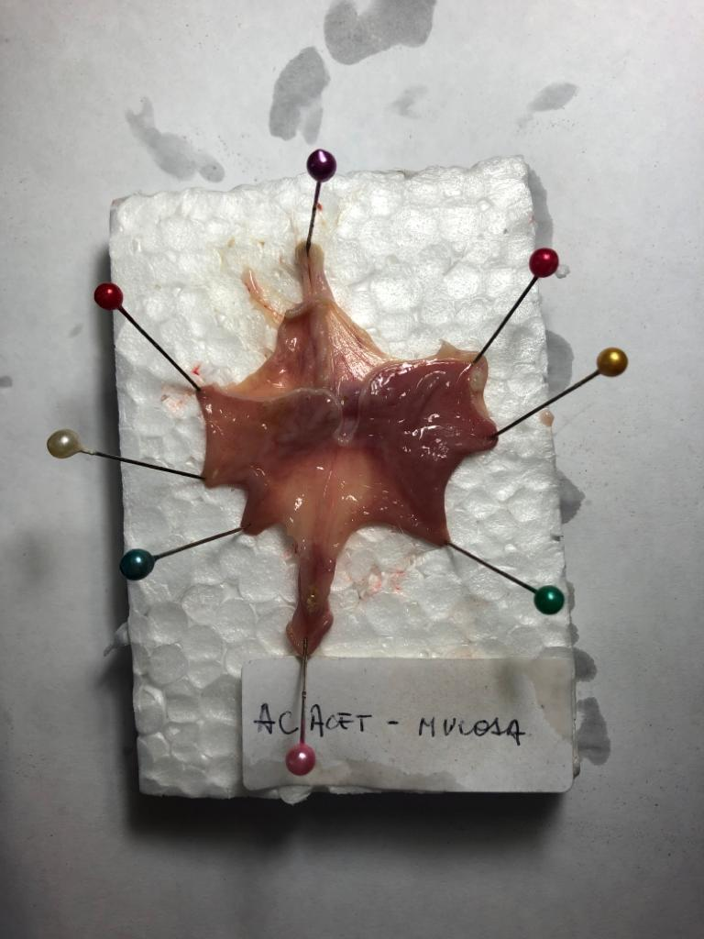
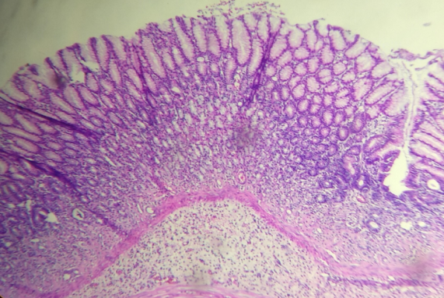
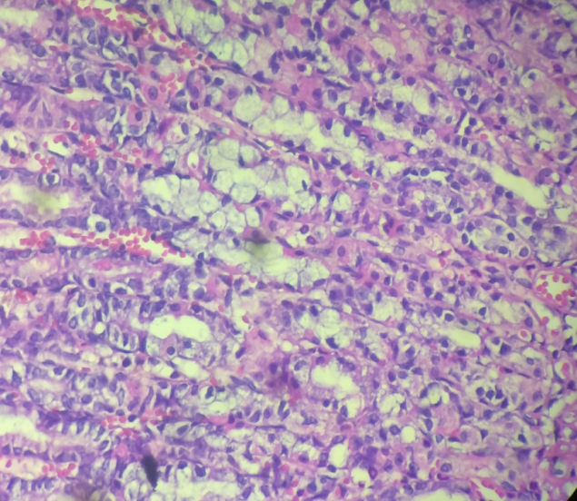
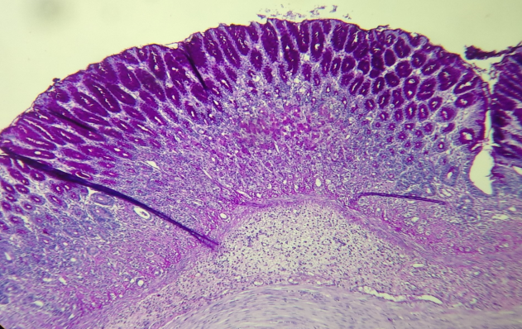
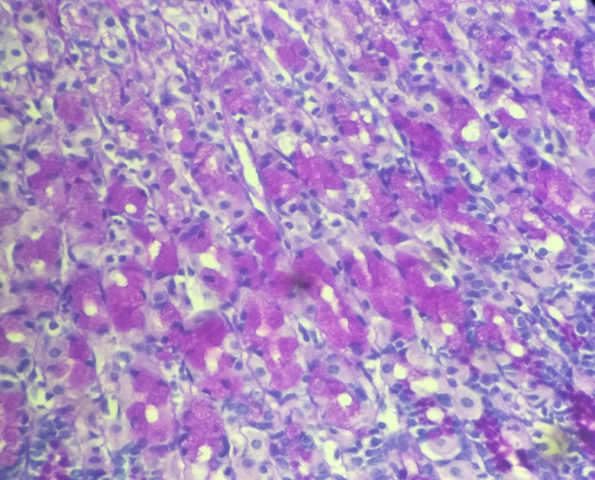
‘
‘STIMULATION OF CELL LINEAGES INVOLVED IN THE REPAIR OF THE GASTRIC MUCOSA (MG) DUE TO THE ULCEROGENIC ACTION OF ACETIC ACID (AC) IN RATS’
Bedini OA, Naves AE, San Miguel P, Petrich K, Vasquez V, Folmer P, Fabbro G, Fabbrizi MR, Flores Trusso L, Villaggi C.
ID 426
Results
Fig. 1
Fig. 2 (H&E, 100x)
Fig. 3
(H&E, 400x)
Group A
(Dissection after 5 days)
Macroscopic examination:
Lesioned area is 4-7 mm ± 3mm (Fig. 1)
Histological examination:
Lymphocytic inflammatory process with reactive vascular proliferation was identified in the submucosa (Fig. 2, Fig. 4)
In the overlying oxyntic (OX) MG, cells with peripheral displacement of the nuclei, with clear, broad cytoplasm, positive with digested PAS staining, and few parietal cells of preserved morphology were observed (Fig. 3, Fig. 5)
No glandular atrophy or deformity of the glandular lumens were found.
Fig. 4 (Digested PAS, 100x)
Fig. 5 (Digested PAS; 400x)

Slide 4
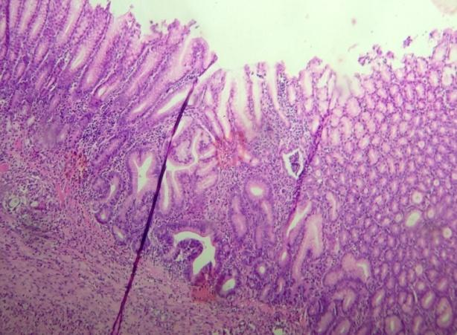
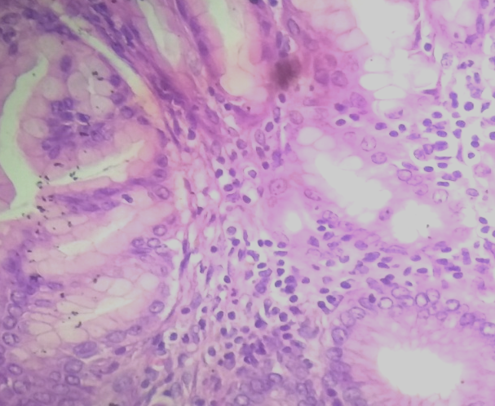
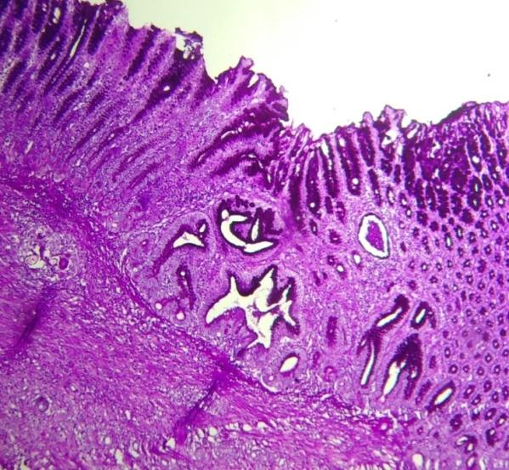
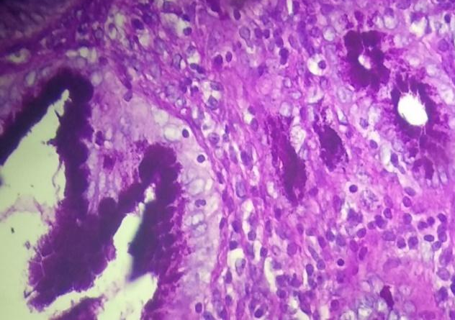
‘STIMULATION OF CELL LINEAGES INVOLVED IN THE REPAIR OF THE GASTRIC MUCOSA (MG) DUE TO THE ULCEROGENIC ACTION OF ACETIC ACID (AC) IN RATS’
Bedini OA, Naves AE, San Miguel P, Petrich K, Vasquez V, Folmer P, Fabbro G, Fabbrizi MR, Flores Trusso L, Villaggi C.
ID 426
Results
Fig. 6 (H&E, 100x)
Fig. 7 (H&E, 400x)
Group B
(Dissection after 21 days)
Macroscopic examination:
No macroscopic lesion is observed
Histological examination:
There is an area of submucosal thickening due to fibrosis, with an overlying area of partially atrophic mucosa, distended glands, irregularly shaped, lined by high epithelium, not OX, positive with digested PAS staining, constituting a pyloric type metaplasic process (MTP) in the gastric body.
Fig. 8 (Digested PAS, 100x)
Fig. 9 (Digested PAS, 400x)

Slide 5
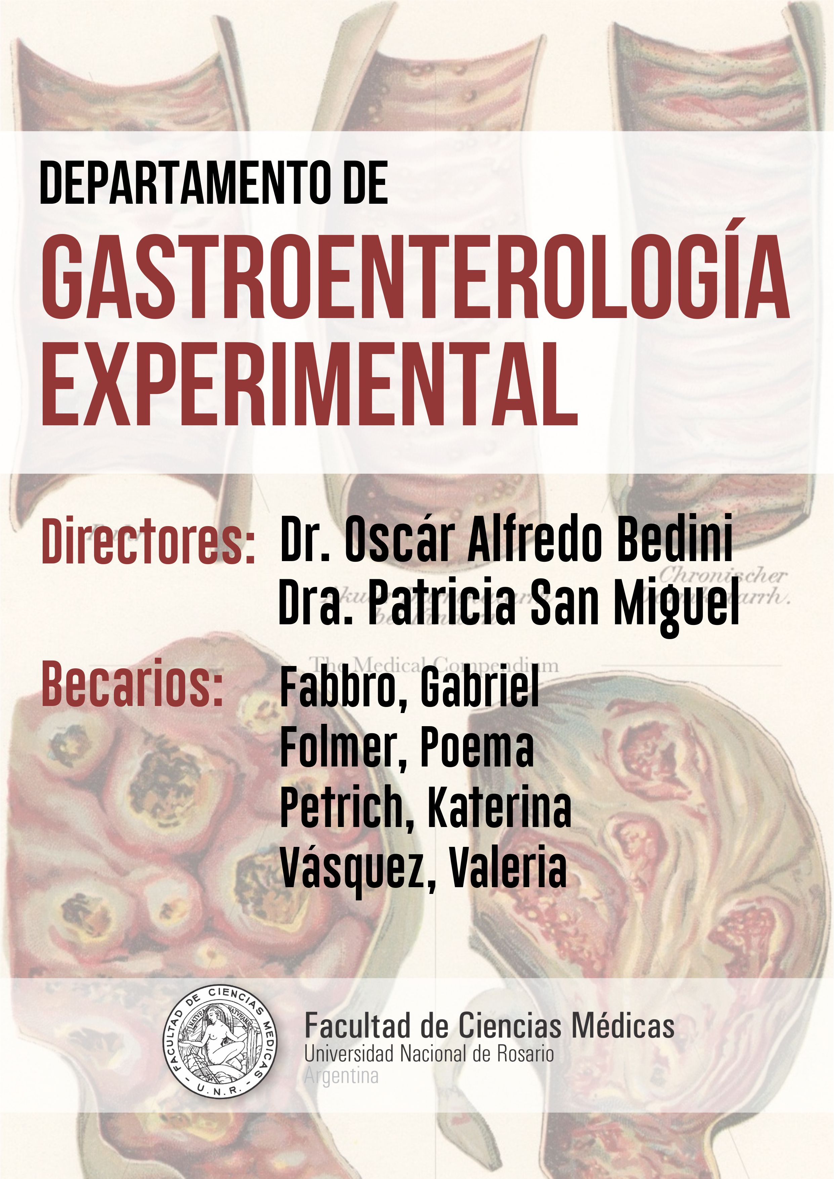
‘STIMULATION OF CELL LINEAGES INVOLVED IN THE REPAIR OF THE GASTRIC MUCOSA (MG) DUE TO THE ULCEROGENIC ACTION OF ACETIC ACID (AC) IN RATS’
Bedini OA, Naves AE, San Miguel P, Petrich K, Vasquez V, Folmer P, Fabbro G, Fabbrizi MR, Flores Trusso L, Villaggi C.
ID 426
Discussion
Our investigation proved that the injection of acetic acid in the subserosa created macroscopic and histological lesion in group A, conserving the oxyntic structure in the gastric body. Group B presented a strongly PAS + epithelium, with depletion of the usual oxyntic cellularity.
This change evidences the presence of a new lineage corresponding to a pyloric type metaplasia in the gastric body.
Therefore, it is shown that the stimulation of the cellular mechanisms of reparation starting from the pyloric antral gland, produced by the mucosal lesion with acetic acid, generates a new lineage of pyloric cells, that, ascending to the oxyntic zone, blocked de acid production by disappearance of the oxyntic glands and depletion of parietal cells, favouring the healing of the ulcer. R
Conclusion
The stimulation of cellular repair mechanisms on the main cells
of the gastric body generated metaplasic cells of the pyloric
type (MTP), configuring a new cell lineage in the gastric body.
THANK YOU FO YOUR INTEREST!
Fabrizzi, Maria del Rosario
Flores Trusso, Lucas

